Slide 1
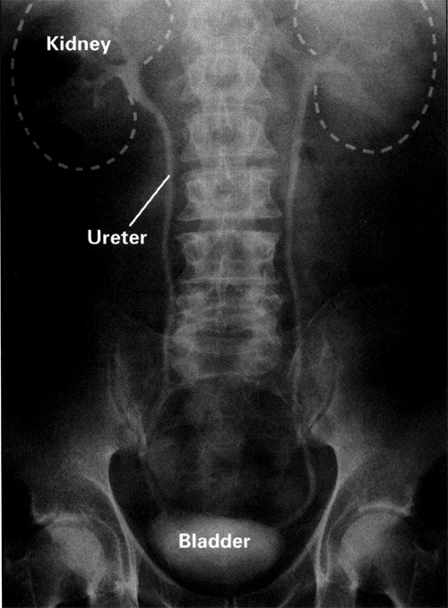
Anatomy
Chronic Kidney
Disease
LECTURE-9-
Hazem.Kadhum Al-khafaji
MD.FICMS
Department of medicine
Al-Qadissiah university

Slide 2
What is CKD?
Presence of markers of kidney damage for three months, as defined by structural or functional abnormalities of the kidney with or without decreased GFR, manifest by either pathological abnormalities or other markers of kidney damage, including abnormalities in the composition of blood or urine, or abnormalities in imaging tests.
The presence of GFR <60 ml/min/1.73 m² for three months, with or without other signs of kidney damage.
Notes:
Most common finding: persistent albuminuria

Slide 3
Definition of Chronic Kidney Disease
Chronic kidney disease is defined as either kidney damage or GFR < 60 cc/min/1.73m² for ≥ 3 months.
Kidney damage is defined as pathologic abnormalities or markers of damage, including abnormalities in blood or urine tests or imaging
NKF/KDOQI Clinical Practice Guidelines for Chronic Kidney Disease

Slide 4
General definitions
Azotemia - elevated blood urea nitrogen (BUN >28mg/dL) and creatinine (Cr>1.5mg/dL)
Uremia - azotemia with symptoms or signs of renal failure
End Stage Renal Disease (ESRD) - uremia requiring transplantation or dialysis
Chronic Renal Failure (CRF) - irreversible kidney dysfunction with azotemia >3 months
Creatinine Clearance (CCr) - the rate of filtration of creatinine by the kidney (GFR marker)
Glomerular Filtration Rate (GFR) - the total rate of filtration of blood by the kidney

Slide 5
Epidemiology Chronic Kidney Disease in the USA
20 million Americans have CKD( 1 in 8 people)
Approx 435,000 have ESRD/HD
Annual mortality rate for ESRD: 24%
20 million others are at risk
Hypertension & Diabetes are the leading causes of kidney failure
23% of all Americans have hypertension
16 million Americans have diabetes
Notes:
CKD is increasing In the US and the world. Over 20 million americans have some degree of renal insufficiency….That is 1 in 8 people.
Another 20 million people are at risk of kidney disease.
The two leading causes of CKD are hypertension and diabetes with 23% of all Americans having hypertension and 16 million Americans having diabetes. The number of people in America with these risk factors is steadily growing and therefore the CKD population will continue to grow.
Hypertension and Diabetes are also independent risk factors for cardiovascular disease. These risk factors make the CKD population at a higher morbidity and mortality rate.

Slide 6
Incidence
There are about 50,000 cases of ESRD per year.
Diabetes: most common cause ESRD (risk 13x )
Over 30% cases ESRD are primarily to diabetes

Slide 7
pathophysiology
1 million nephrons in each kidney.
Destruction of part of these nephrons leads to componsatory hypertrophy & hyperfiltration of remaining nephrons –--> increased glomerular capillary pressure & evantually sclerosis of these glomeruli.

Slide 8
Factors causing progressive renal injury
1- systemic hypertension
2- Proteinuria
3- Increased renal amoniogenesis
4- Hyperlipidaemia
5- Hyperphosphataemia with Calcium phosphate deposition
6- Decrease level of nitrous oxide
7- Smoking

Slide 9
What stage of CKD now?
Although, the stages are generally progressive but we & the patient can impact or slow the progression of kidney disease with diet, medications and healthy behaviors.
Stage 1 – GFR ≥ 90 cc/min/1.73m²
Kidney Damage with normal or high GFR
Stage 2 – GFR – 60 to 89 cc/min/1.73m²
Kidney Damage with mildly decreased GFR
Stage 3 – GFR – 30 to 59 cc/min/1.73m²
Moderate decreased GFR
Stage 4 – GFR – 15 to 29 cc/min/1.73m²
Severely decreased GFR
Stage 5 – GFR - < 15 cc/min/1.73m²
Kidney failure
NKF/KDOQI Clinical Practice Guidelines for Chronic Kidney Disease
Notes:
This is the question most patients ask. We review kidney function and the stages of kidney disease. We review how this calculation works and that is based on both kidneys. We discuss that the stages are generally progressive but that patients can impact or slow the progression of kidney disease with diet, medications and healthy behaviors. Patients need to be informed and ask lots of questions of their health care team and physicians.

Slide 10
Aetiology
1- diabetes mellitus(20-40%)
2- Hypertensive renal diseases
3- Primary renal diseases such as G.N
4- Secondary renal diseases such as SLE.
5- tubulo-interstitial nephritis.
6- poly cystic kidneys.
7- renal artery stenosis
8- Pyelonephritis
9- Undetermined cause(5-20%)

Slide 11
Symptoms and Signs of Early Stages of CKD
Most patient in stage 1- 3 a symptomatic
There may be general non specific signs & symptoms as Weakness
Decreased appetite & Nausea
Changes in urination (nocturia, polyuria, frequency)
Nocturia may be the earliest feature of CKD.
Blood in urine or dark-colored urine
Foamy urine
Loin pain
oedema
Elevated blood pressure
Pale skin

Slide 12
Symptoms and Signs of Late (Uremic) Stages of CKD
General ( lassitude , fatigue , elevated blood pressure , signs of volume overload , decreased mental acuity , intractable hiccups , uremic fetor )
Skin (sallow appearance, earthy coulored, pruritic excoriations )
Pulmonary ( dyspnoea , pleural effusion , pulmonary edema , uremic lung )
Cardiovascular ( pericardial friction rub , congestive heart failure )
Gastrointestinal ( anorexia , nausea , vomiting , weight loss , stomatitis , unpleasant taste in the mouth )
Neuromuscular ( muscular twitches , peripheral sensory and motor neuropathies , muscle cramps , restless legs , sleep disorders , hyperreflexia , seizures , encephalopathy , coma ) Endocrine-metabolic ( decreased libido , amenorrhea , impotence ) Hematologic ( anemia , bleeding diathesis )

Slide 13
Metabolic changes:
1- Acidosis,the patient breathing deep & slow.
2- Hypocalcaemia.
3- Hyperphosphataemia.
4- Hypomanasaemia.
5- Hyperparathyroidism(secondary&tertiary)
6- Renal osteodystrophy: osteomalacia,osteoporosis,fibrosing osteitis cystica.

Slide 14
Electrolyte Abnormalities
Excretion of Na+ is initially increased, probably due to natriuretic factors
Maintain volume until GFR <10-20mL/min, then oedema
3. Tubular K+ secretion is decreased.Hyperkalaemia is the most dangerous complication.

Slide 16
Assessment and Diagnostic Findings
Glomerular filtration rate: GFR (see next slide) is decreased resulting in a decrease in creatinine clearance, whereas the serum creatinine and BUN levels increase. Serum creatinine is the more sensitive indicator of renal function because of its constant production in the body..
Sodium and water retention: In ESRD, some patients retain sodium and water, increasing the risk for edema, heart failure, and hypertension. Other patients may lose salt and run the risk of developing hypotension and hypovolemia.

Slide 17
Calculations
Cockcroft-Gault
Men: CrCl (mL/min) = (140 - age) x wt kg)
SCr(mg/dl) x 72
Women: multiply by 0.85

Slide 19
Serum creatinine has a drawback in the measurement of glomerular filtration rate (GFR) in that it may vary according to muscle mass & may be influeced by proteinous meal.
What is the alternative?

Slide 20
Thank you
Next lecture Management of CKD

