Slide 1
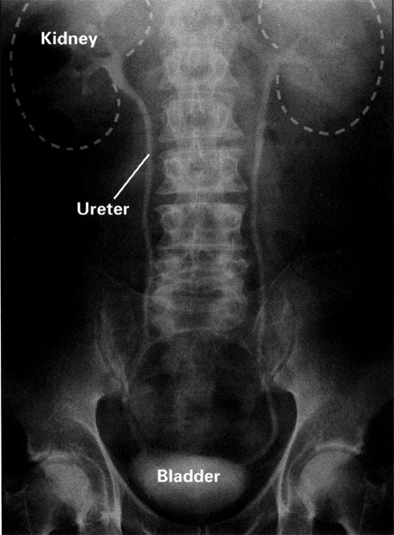
Anatomy
Management of
CKD
LECTURE
10
Hazem.Kadhum Al-khafaji
MD.FICMS
Department of medicine
Al-Qadissiah university

Slide 2
What can I do
For the patient with CKD??

Slide 3
Investigations Depending on the stage of CKD,possible primary cause & associated conditions & suspected complications
Urinalysis
Urine albumin-to-creatinine ratio (UACR)
creatinine with estimated GFR, blood urea nitrogen (BUN), electrolytes(specially potassium & sodium), glucose & HbA1c, calcium, phosphorus, albumin, lipids.
ECG
complete blood count (CBC)
Renal ultrasound.
For further evaluation, the following tests are often ordered, depending on clinical presentation & staging:
parathyroid hormone
Fe,ferritin , folate & B12
Hepatitis B serology(if negative vaccination) , hepatitis C serology
Antinuclear antibody test (ANA)
Rheumatoid factor (RF)
complements (C3) & (C4)
Serum protein electrophoresis (SPEP) and urine protein electrophoresis (UPEP) (in patients over the age of 40).
Renal biopsy in certain conditions.

Slide 4
CKD Risk Factors
Susceptibility
Advanced age Reduced kidney mass and low birth weight Racial/ethnic minority Family history Low income or education Systemic inflammation Dyslipidemia
Initiation
Diabetes mellitus Hypertension Glomerulonephritis
Progression
Glycemia (among diabetic patients) Hypertension Proteinuria Smoking Obesity

Slide 5
CKD treatment guidelines: 1-Treatment of potentially treatable underlying Disease.
2- Slow the progression of nephrons loss.
3- Avoid & treat reversible factors of uremia.
4- Symptomatic treatment of uremia.
5- Treatment of ESRD.

Slide 6
1-Treatment of potentially treatable underlying diseases
1-Diabetes mellitus :Type 1 DM patients: 40% lifetime risk of developing CKD
Type 2 DM patients: 50% lifetime risk of developing CKD .
2- Hypertension: Early HTN treatment to aggressive goals slows CKD progression
:3- Glomerulonephritis : some cases still response to immunosuppressive drugs.

Slide 7
2- Slow the progression of nephrons loss.
1- Dietary & lifestyle interventions:
low-protein diet of variable benefit
low-protein diet (0.6 g/kg/day) may reduce rate of renal function decline & delay the time to reach end-stage kidney disease, & onset of uremic symptoms.
Smoking cessation
Reduction of body weight.
Exercise.
2- Control of hypertension: achieved by ACEI & / or ARBs , some time non-dihydropyridine CCBs as verapamil.The target BP 130 / 80 mmHg & 125/ 75 mmHg in diabetics or patient with proteinuria.
3-Proteinuria reduction:
Most clinicians use ACEI/ARB therapy in patients to reduce proteinuria specially in diabetic patients.
4- Strict glycaemic control.

Slide 8
Supportive therapies may slow CKD progression
Dietary protein restriction
Lipid-lowering medications
Smoking cessation
Anemia management
Limit progression with hyperglycemia & HTN treatment.
Reduction of body weight

Slide 9
3- Avoid & treat reversible factors of uremia.
Avoid:
Dehydration.
Nephrotoxic drugs.
Radiocontrast media.
Hypotension due to any cause.
Heavy proteinous meal.
Pregnancy.
Urgent treatment for:
Obstructive uropathy.
Urinary tract infection.
Infection any where.

Slide 10
4- Symptomatic treatment of uremia
Maintain normal electrolytes & nutritional support.
Potassium, calcium, phosphate are major electrolytes affected in CRF
Renal diet including high calcium and low phosphate phosphate starting to increase in stage 3 CKD
Ca²⁺, phosphorus, PTH correction may reduce CV risk in addition to renal osteodystophy.
Phosphate binders: AlOH, calcium carbonate, calcium acetate, lanthanum carbonate, sevelamer
GIT symptoms treated with proton pump inhibitors & anti-emetic, sometime GIT bleeding.
Renal osteodystrophy treated with calcium supplement as cholecalciferol.
Anaemia by erythropoietin & iron supplement , sometime blood transfusion. platelet disorder, pericarditis, Peripheral neuropathy
.

Slide 11
Signs & symptoms of CKD Stages
System | Signs & symptoms of CKD
Cardiovascular–pulmonary | Pulmonary oedema, worsening hypertension, pericarditis(sometime tamponade),accelerated atherosclerosis(CHD), arrhythmias, left ventricular hypertrophy, dyslipidemia
Gastrointestinal | GERD, weight loss, nausea & vomiting
Endocrine | 2˚ hyperparathyroidism(sometime tertiary), decreased vitamin D activation, β₂-microglobulin deposition, gout ,renal oesteodystrophy.
Hematologic | anemia of CKD, iron deficiency, bleeding tendency.
Fluid/electrolytes | hyper- or hyponatremia, hyperkalemia, metabolic acidosis,hypocalcaemia,hyperphosphataemia.

Slide 12
Nutrition of patient with CKD
Low-protein diets may slow the progression of mild and moderate renal insufficiency. Therapeutic diets using plant sources of protein are more effective in delaying the progression of renal insufficiency, compared to those using animal proteins.⁵
Vegan (pure vegetarian) diets have been shown to provide adequate protein.
Dialysis Patients
Dialysis changes dietary needs. Patients undergoing typical hemodialysis, involving about three treatments per week, follow diets that are restricted in protein, sodium, potassium, phosphorus, and fluid. Patients on continuous ambulatory peritoneal dialysis, involving several dialysate exchanges per day, can be more liberal in protein, sodium, potassium, and fluid intake

Slide 13
5- Renal replacement therapy: Dialysis Renal transplantation

Slide 14
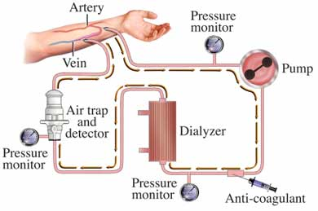
Hemodialysis
3-4 times a week
Takes 2-4 hours
Machine filters
blood and return it
back to the body.
returns it to
body

Slide 15
Types of Access
Temporary site
AV fistula
Surgeon constructs by combining an artery and a vein
3 to 6 months to mature
AV graft
Man-made tube inserted by a surgeon to connect artery and vein
2 to 6 weeks to mature

Slide 16
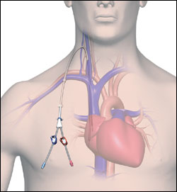
Temporary Catheter

Slide 17
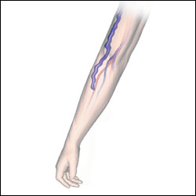
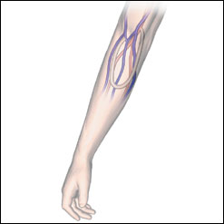
AV Fistula & Graft

Slide 18
Thank you
Next lecture Urinary tract infection

